Slide 1
Solar Powered Phone Charging Station
ECE 4970W – Department of Electrical and Computer Engineering
Trevor Oistad, B.S. Electrical Engineering
Sheng Ma, B.S. Electrical Engineering
Michael Brown, B.S. Computer Engineering
Michael Miller, B.S. Computer Engineering
Dr. Robert O’Connell PhD, PE, Kemper Fellow
Department of Electrical and Computer Engineering, University Missouri
Notes:
Sheng starts

Slide 2
Overview
Part 1: Introduction
Part 2: Scope
Part 3:Implementation
Part 4: Project Evaluation
Part 5:Financial Costs
Part 6:Timeline
Part 7: Summary and Conclusions

Slide 3
Part 1: Introduction
Rationale
Prototype Concept
Engineering Merit

Slide 4
Rationale to our Prototype
Smartphone usage is vital for people all over the world
Phone dying = unfortunate inconvenience
Electrical outlets typically indoors
Phone chargers rely on electric grid = coal and natural gas
Search for solutions to phone charging while mindful of resource impact

Slide 5
Prototype Concept
Solar powered
Self-sustaining
Charge multiple phones at a time
Commercially available
Located in high traffic areas

Slide 6
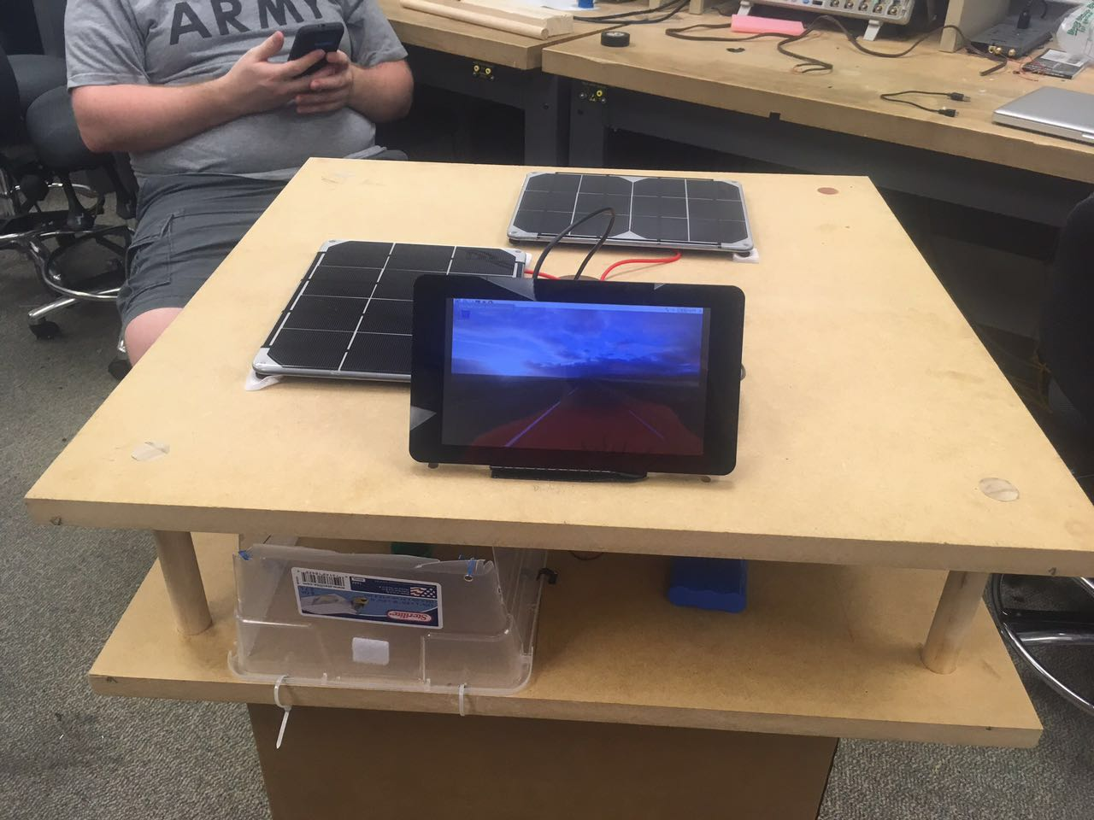
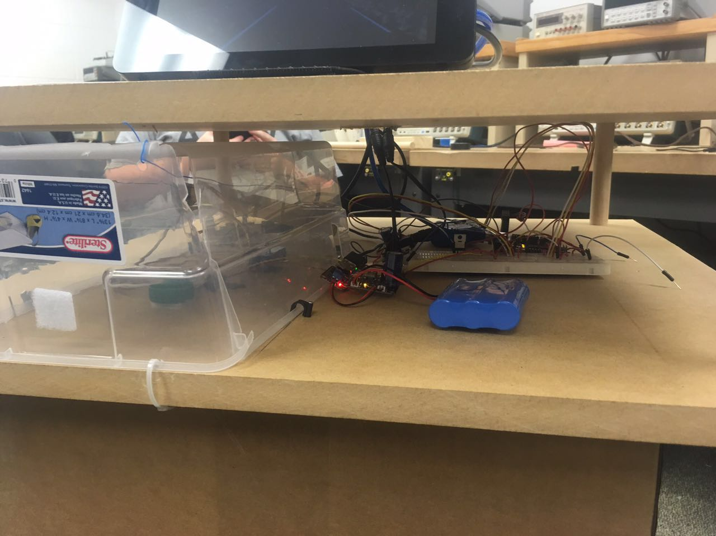

Slide 7
Engineering Merit
Solar power
Security of private property
Charging storage bins
Public, open source use
Combination of these => our prototype
Notes:
Sheng ends

Slide 8
Part 2: Scope
Goals and Objectives
Critical Specifications
Constraints
Standards & Assumptions

Slide 9
Individual Goals and Objectives
SMART GOAL: Consider power system that can adequately charge all devices in the prototype
Specific: The prototype needs to produce enough power to power multiple phones, an Arduino, raspberry pi, and a LCD monitor. The best possible action that is efficient and cost-effective will be chosen.
Measurable: Each will have their own input voltage and current, requiring us to design our system focusing on these aspects.
Achievable: This will be achieved by consulting professors within the ECE department as well as researching power electronics and sustainable energy
Relevant: This will allow the prototype to fulfill its goal as a self-sustaining device off the grid
Time-Based: This process must be considered first and implemented first in order for the other hardware and software functions to do their duties.

Slide 10
Individual Goals and Objectives
SMART GOAL: Successfully create software system to protect prototype
Specific: Monitor system attributes and theft using alarms, temperature sensors, and scales
Measurable: The sensor data that is monitoring the power system will be used as input to control internal protection system.
Achievable: This can be achieved working with university professors and prior knowledge from previous courses
Relevant: In the modern age of technology, safety is a number one priority for consumers regarding cyber security. Safety from fire hazards is also of great importance.
Time-Based: This goal can be accomplished throughout the project and can be adjusted according the prototypes needs.

Slide 11
Individual Goals and Objectives
SMART GOAL: Provide means to improve our customers experience with our prototype
Specific: Keep track of charging data for each cellphone user that uses our prototype and use that data to improve their experience
Measurable: Record time each phone takes to charge and their type of phone, and use that data to adjust the charging rate.
Achievable: Consulting with Computer Science Professors at the university will be of utmost importance.
Relevant: Users should have a positive experience using the prototype
Time-Based: The production of this application will take an estimate seven days to complete.

Slide 12
Individual Goals and Objectives
SMART GOAL: Making sure the temperature of the battery is within safe area, and the force sensor is sensitive enough
Specific: The temperature of battery should be kept under 30° , and the force sensor can sense the phone above it
Measurable: The data from temperature sensors and force sensor is transmitted to computer, it can be used to calibrate the sensors
Achievable: This can be achieved by searching the Internet
Relevant: It is about the safety and efficiency of the station
Time-Based: This goal can be achieved in an estimate two weeks, and they can be adjusted according to the prototype needs
Notes:
Sheng

Slide 13
Customer – Centric Goal
SMART GOAL: Prototype should provide convenience and security to the private property of the consumer
Specific: Prototype should have features that make the usage by the customer feasible and pleasurable.
Measurable: Set standard to what we want to make prototype safe and marketable
Achievable: Research online sources, consult professors
Relevant: The prototype puts the burden of safety on us, and we need to make sure our users property are protected and safe
Time-Based: This will take the entire length of the project to keep for consideration and adjustments

Slide 14
Engineering Goals
Sustainability: Prototype should be self-sustaining in terms of power generation and safety protocols
Environmental: Prototype will rely on zero power from energy grid
Social: Prototype offers USB charging access in populated areas
Manufacturability: Prototype can be produced and accommodated to different demands
Economic: Charger can be used in as perk of being student, no extra cost to the consumer

Slide 15
Sustainability
SMART GOAL: Prototype should be self-sustaining in terms of power generation and safety protocols
Specific: Keep track of amount of power consumed by Rasperry Pi, touchscreen, and Arduinos
Measurable: Record the amount of power over time the Raspberry Pi and Arduinos consume under different conditions of stress.
Achievable: We’ve consulted with Dr. Fischer about using his tools to measure voltage and current in a non-invasive manner.
Relevant: The prototype should be able to operate under bare minimum power conditions
Time-Based: This will take the entire length of the project, plus additional time to retrieve data after the prototype has been built

Slide 16
Environmental
SMART GOAL: Prototype will rely on zero power from energy grid
Specific: Keep track of amount of power consumed by batteries and supplied by solar panels.
Measurable: Record the time it takes to fully charge and fully drain the batteries, as well as the rate of power supplied by the solar panels at different times of the day and under different weather conditions.
Achievable: We’ve consulted with Dr. Fischer about using his equipment to read current and voltage from solar panels.
Relevant: Solar panels are a very clean and efficient source of energy.
Time-Based: The production of this application will take the entire length of building the prototype, and we will continue to measure the amount of power supplied after the prototype has been built.

Slide 17
Social
SMART GOAL: Prototype offers USB charging access in populated areas
Specific: Take data on how useful our services are to smartphone users
Measureable: Survey users of our service on convenience and accessibility of prototype.
Achievable: We will need to test our prototype areas of high traffic on campus
Relevant: Understanding the usefulness of our project can help us to better improve certain aspects
Time-Based: This will take no more than a week, and will be done after the building of our prototype.

Slide 18
Manufacturability
SMART GOAL: Prototype can be produced and accommodated to different demands
Specific: Better understand the amount of demand our prototype has in certain areas and under certain conditions
Measureable: Record the amount of people that desire to use our services along with a timestamp
Achievable: We will code in a method to record the time, date, and increment a number to keep track of the amount of users
Relevant: Knowing how many people use our services can allow us to modify our prototype to accommodate more phones at a time
Time-Based: This will be done after our prototype has been built, and will take no less than a week

Slide 19
Economic
SMART GOAL: Charger can be used in as perk of being student, no extra cost to the consumer
Specific: We can market our prototype to Universities or businesses that can offer our prototype to their students/employees
Measureable: Survey students and employees on how likely they are to use our prototype if it were provided to them for free
Achievable: We will test our prototype near campuses and business locations
Relevant: This would allow for our services to be provided to people who need them at no cost
Time-Based: This will be completed after our prototype has been built

Slide 20
Prototype Specifications
4 Elements: Software, solar energy harnessing, battery charging / regulation, phone charging
Software:
Raspberry Pi : 5.1 VDC, 700mA
Arduino Uno : 9-12 VDC, 250mA
Computer Monitor: Sunfounder 7in HD, 12 VDC, 6W

Slide 21
Prototype Specifications
Solar Energy Harnessing
2Photovoltaic Solar panels: 6v, 3.5W each, 3.69W at peak power
Parallel circuitry for maximum power while retaining 6V necessary for charger
USB, Solar, Lithium Ion charger will regulate 3.7V to avoid damage to battery
Lithium Ion Battery 3.7V at 15600mAh (six 18650 batteries in parallel)
Battery Charging / Regulating
USB, Solar, Lithium Ion charger will regulate 3.7V to avoid damage to battery
Lithium Ion Battery 3.7V at 15600mAh (six 18650 batteries in parallel)

Slide 22
Prototype Specifications
Phone Charging
DC/DC Boost Converter to produce 5V at 1000mA to meet charging requirements
Wireless Charger / Charging Base
Force Sensors for reading .04g/mm to 4.5kg/mm
Average charging device: 200g to 500g
Electronic Lock: Micro Servo with Arduino
3 to 6 V from DC/DC Boost
Torque 1.6kg/cm
90 degree rotation

Slide 23
Constraints?
Wireless Access
Self Powering
Outdoor Durability
Waterproof
Additional Modules
Battery Sustainability
Weather (Testing / Real use )

Slide 24
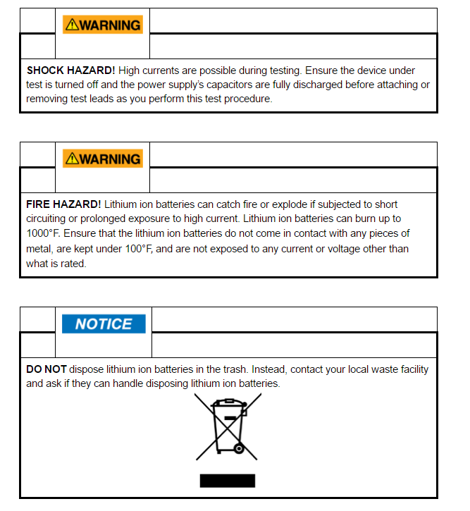
Standards, Assumptions, Safety
ANSI Z535
OSHA
PSES IEEE

Slide 25
Part 3: Implementation
Proposed Implementation
Demonstrated Implementation

Slide 26
Proposed Implementation
General Power system: photovoltaic solar panel, charger, battery, DC/DC converter
Parallel linkage of Solar panels
18650 Lithium Ion batteries
Self powering system
Temperature controlled
SCADA system
User interface for student login

Slide 27
Proposed Function Block Diagram

Slide 28
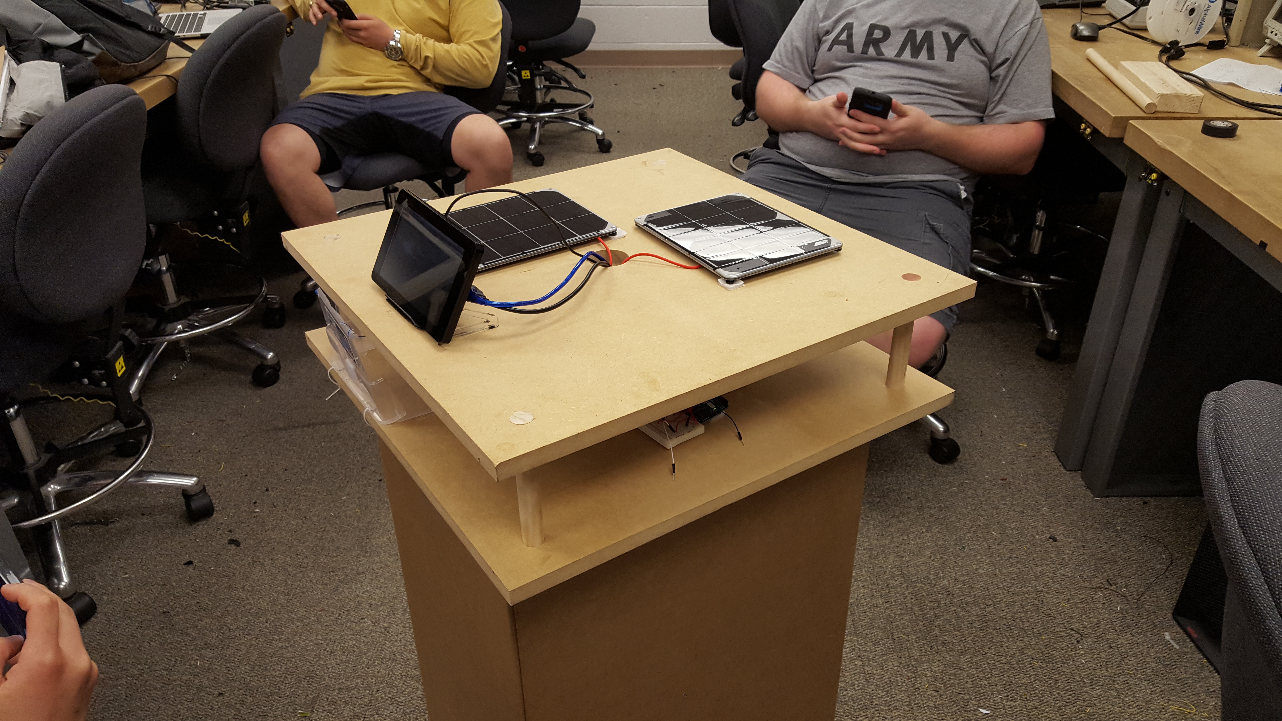
Demonstrated Implementation

Slide 29
Solar Panels and Power Diversion

Slide 30
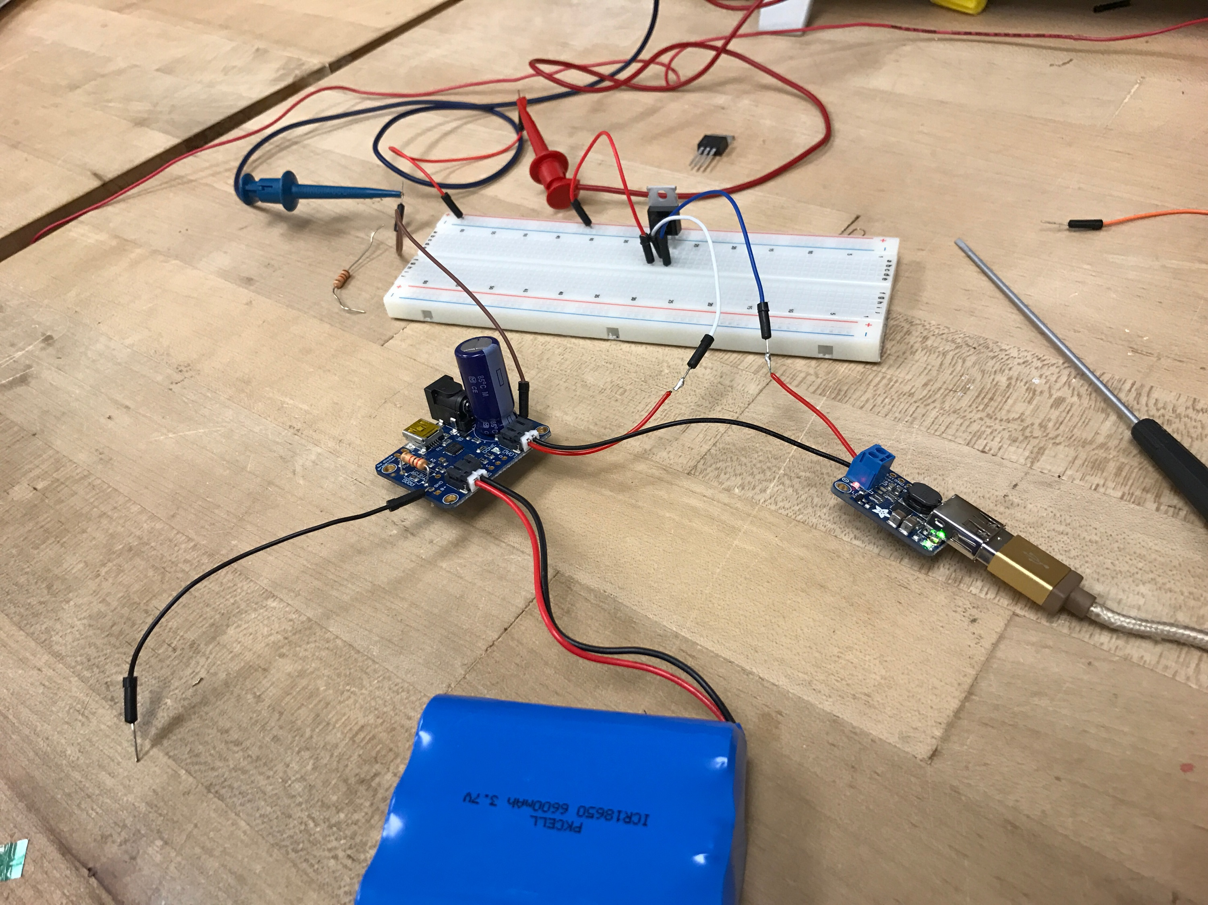
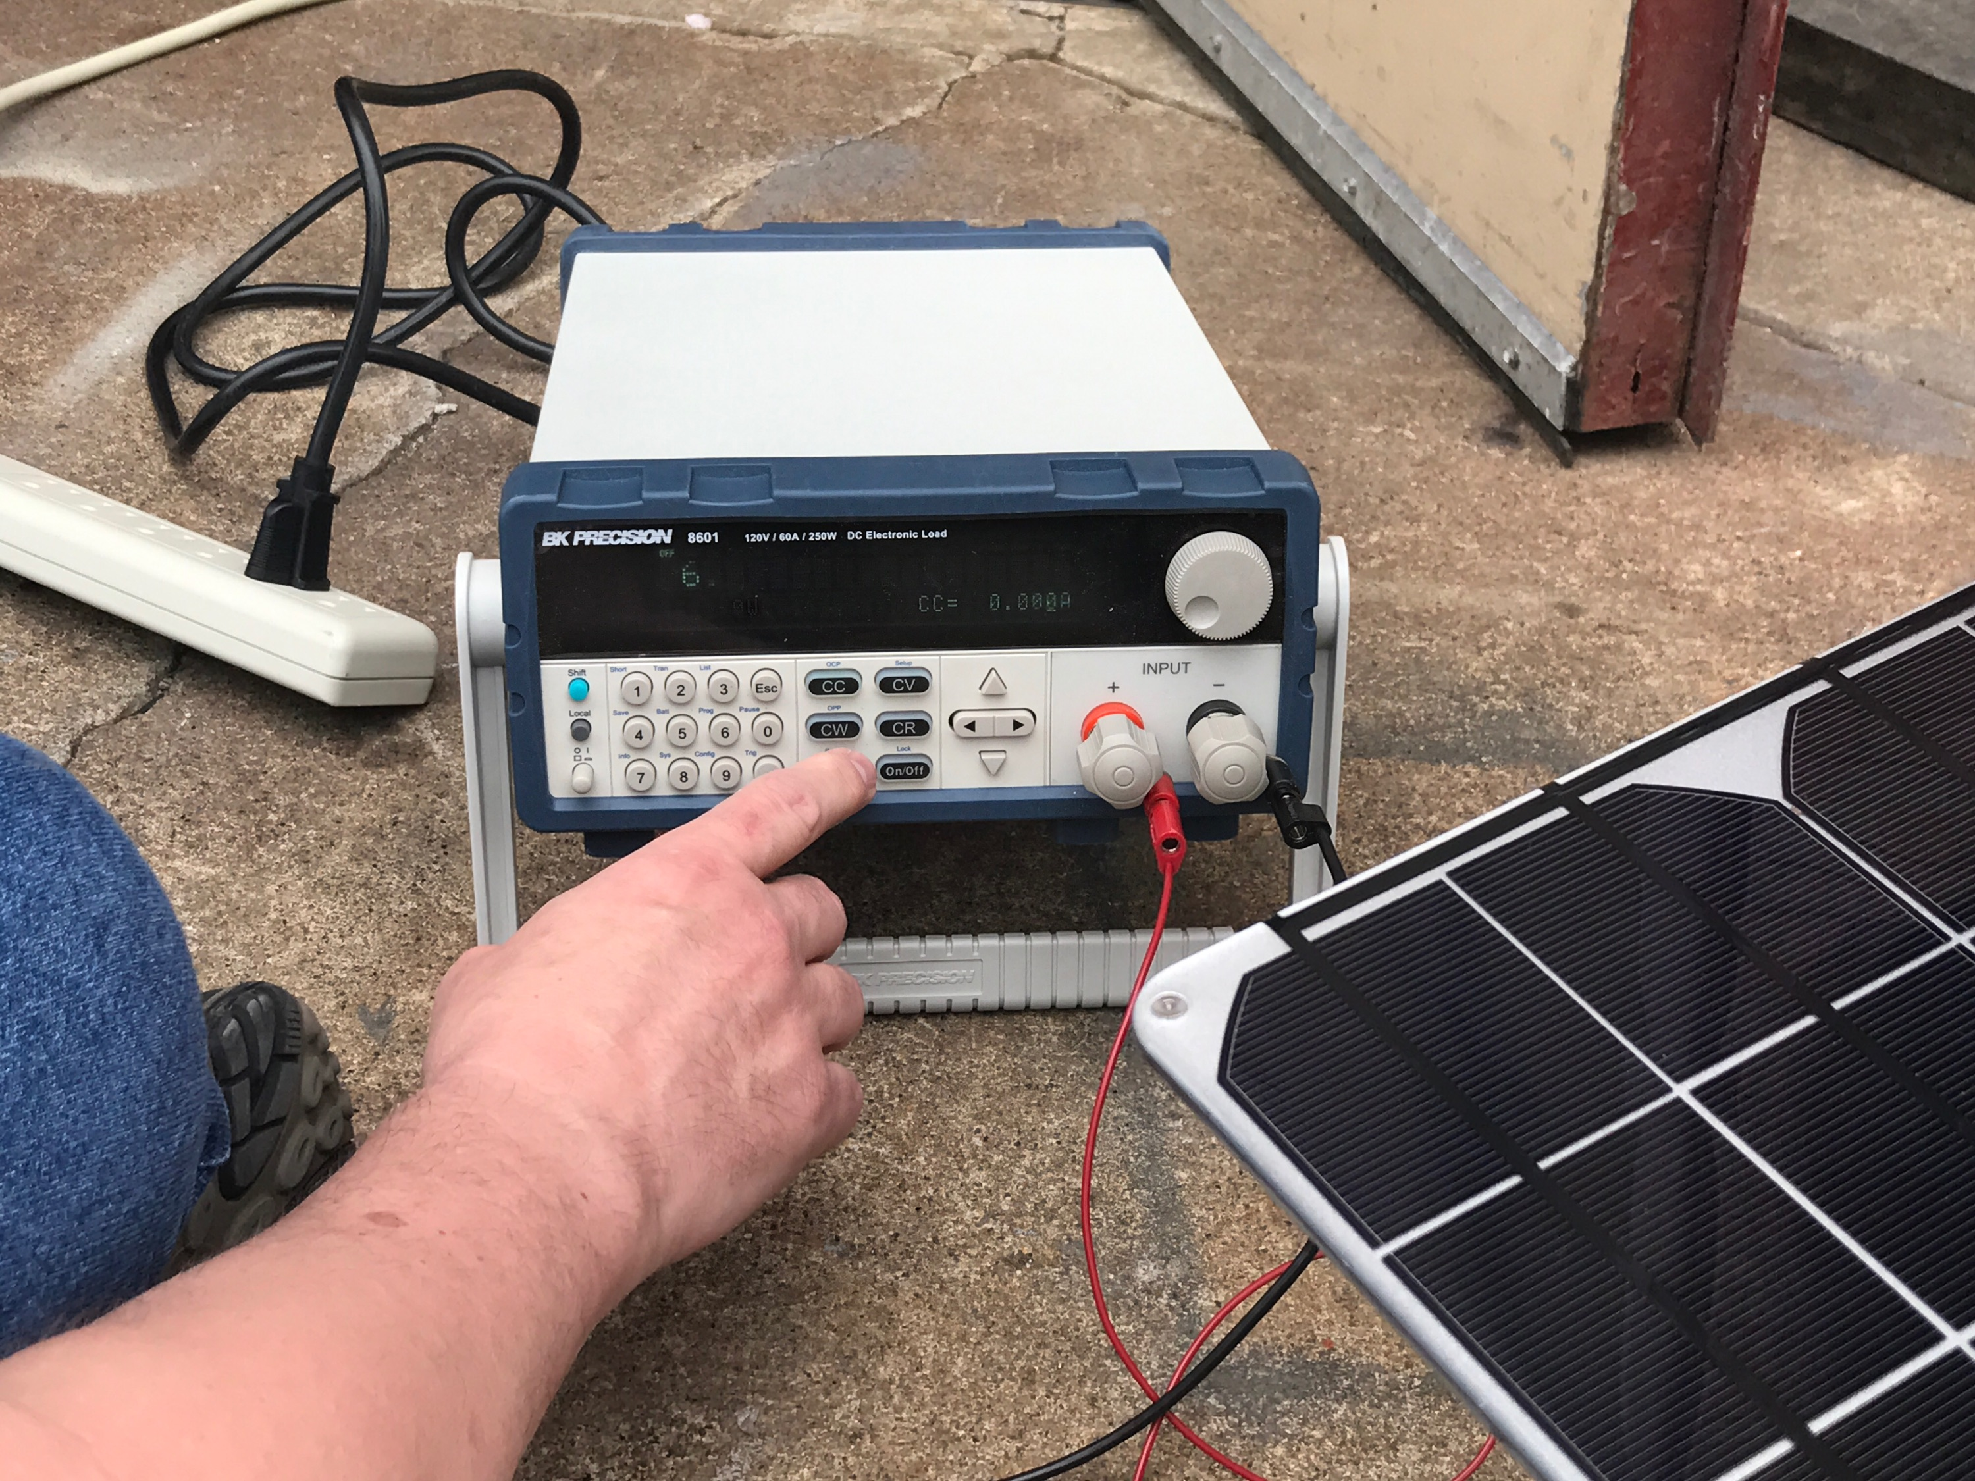

Slide 31
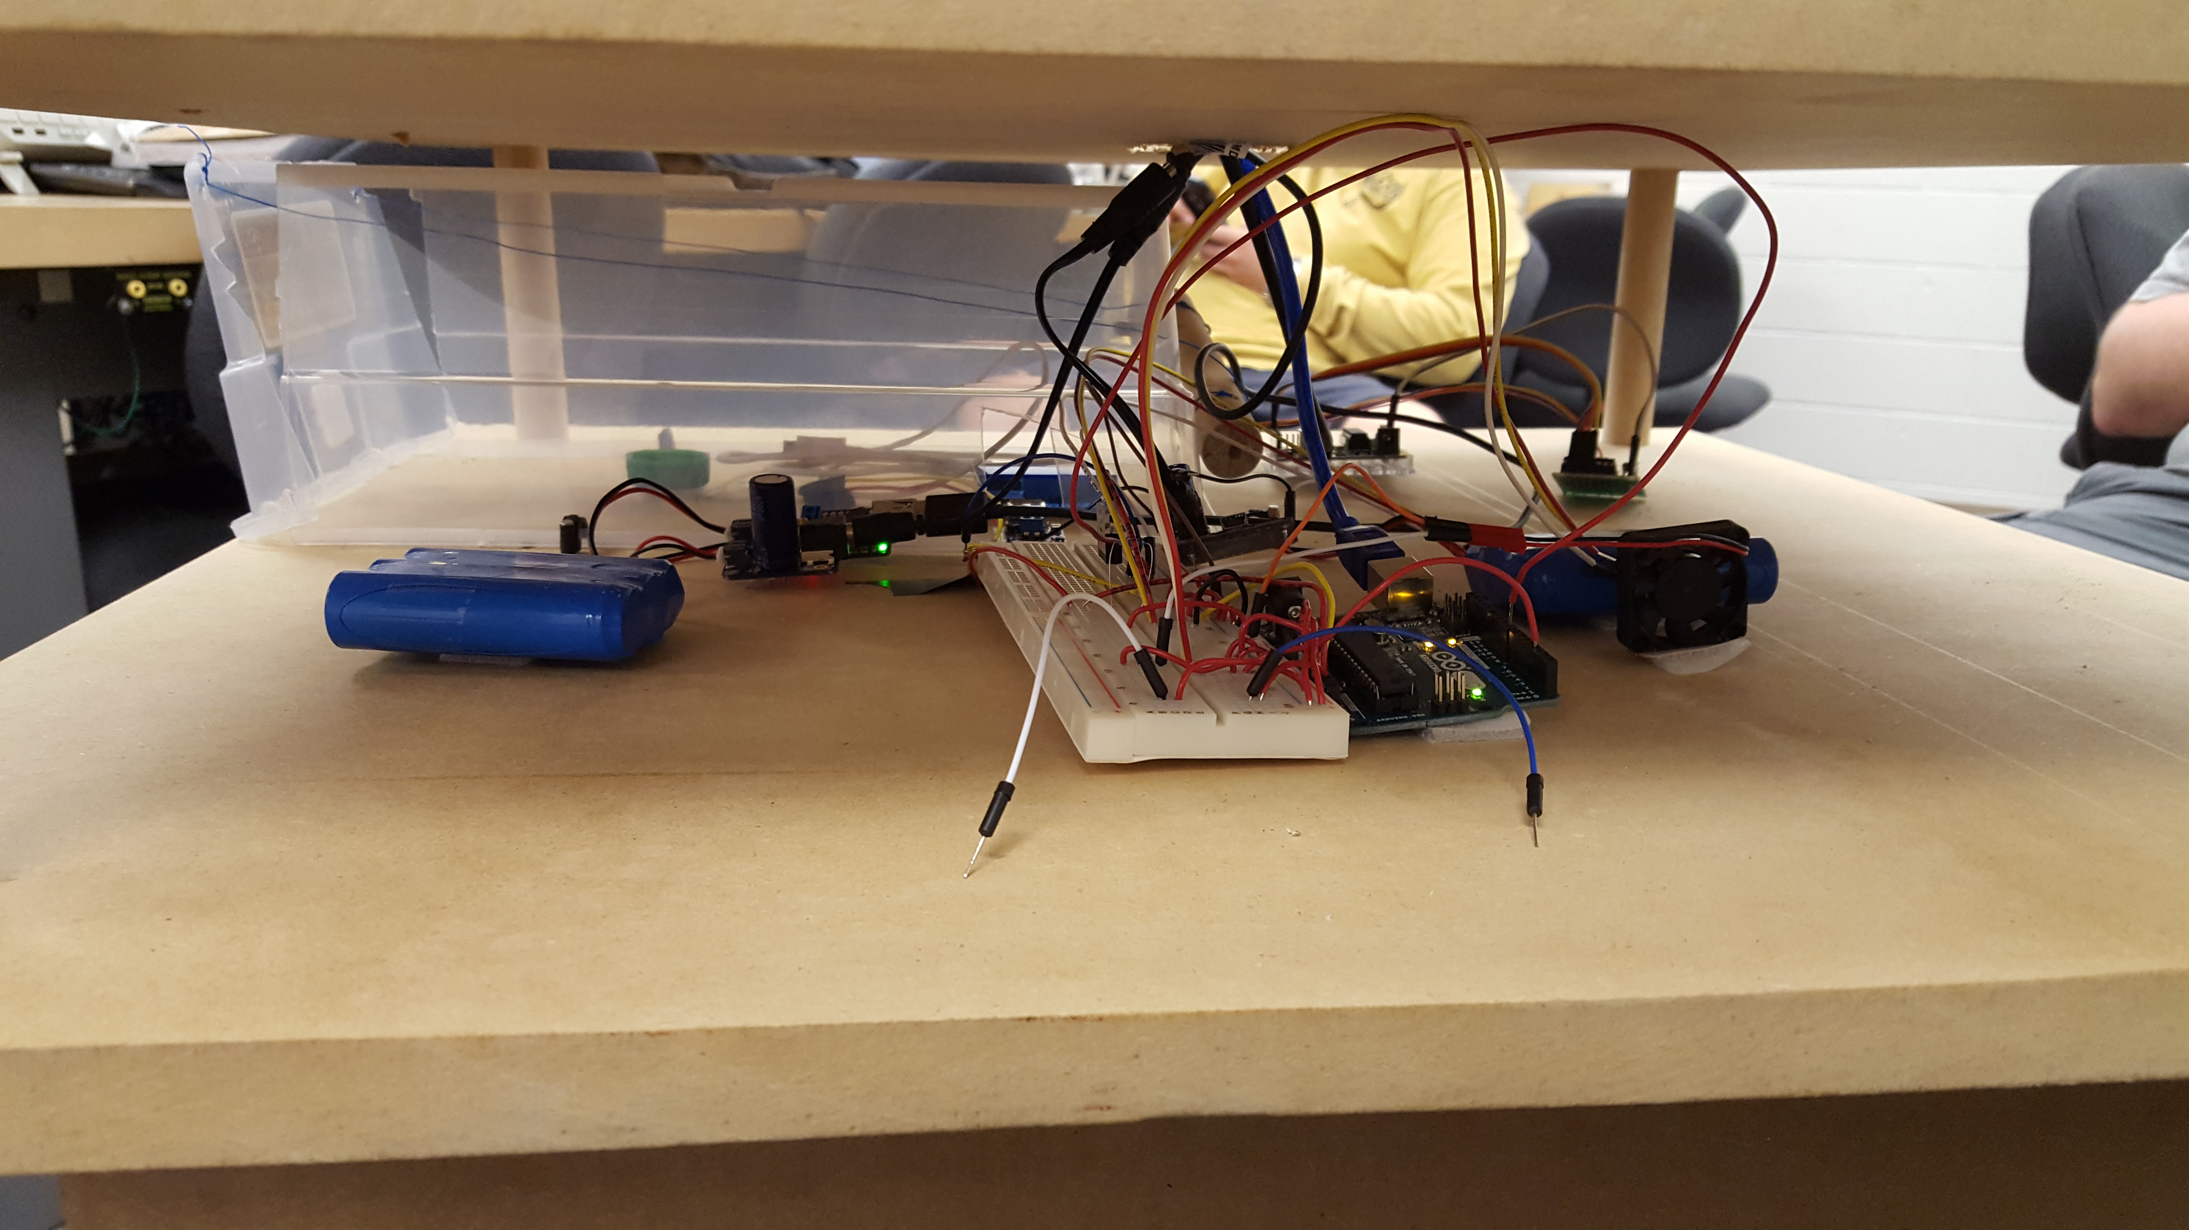
Arduino 1

Slide 32
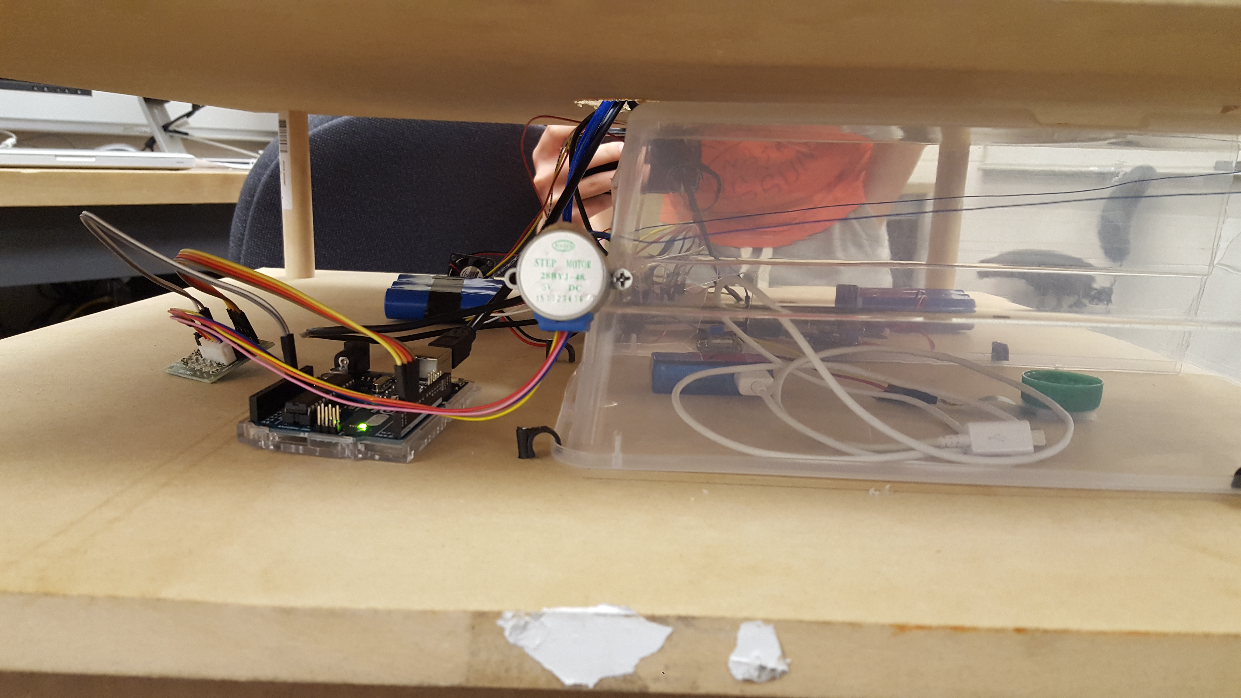
Arduino 2 to Raspberry Pi
Stepper Motor
Motor driver
Plastic Container
USB to B (serial communication)

Slide 33
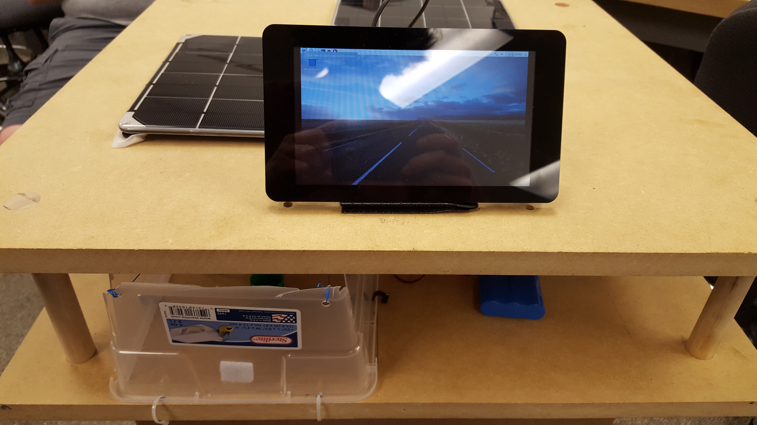
Raspberry Pi
OS: Raspbian
Touchscreen display
Website interface

Slide 34
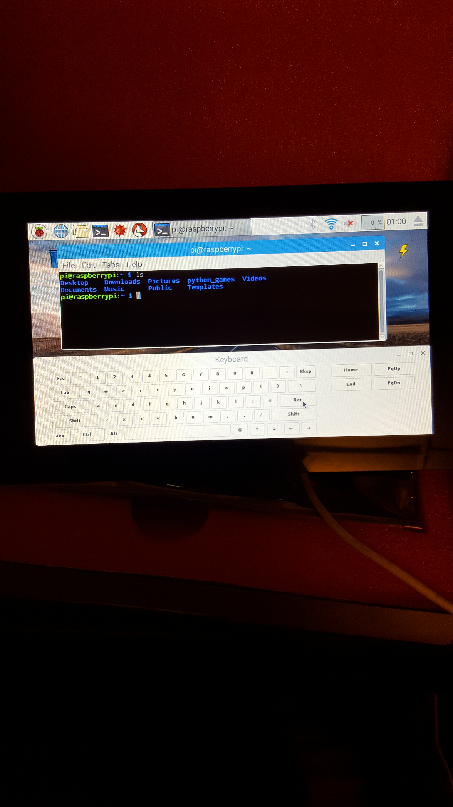
Raspberry Pi Raspbian (Debian)
Linux Based Terminal
Socket Server in C
Socket Client in PHP
Used get-apt install to install dependencies such as LAMP
MYSQL, PHP, Apache, PHP-MYSQL, Apache-PHP-MYSQL, MYSQL server

Slide 35
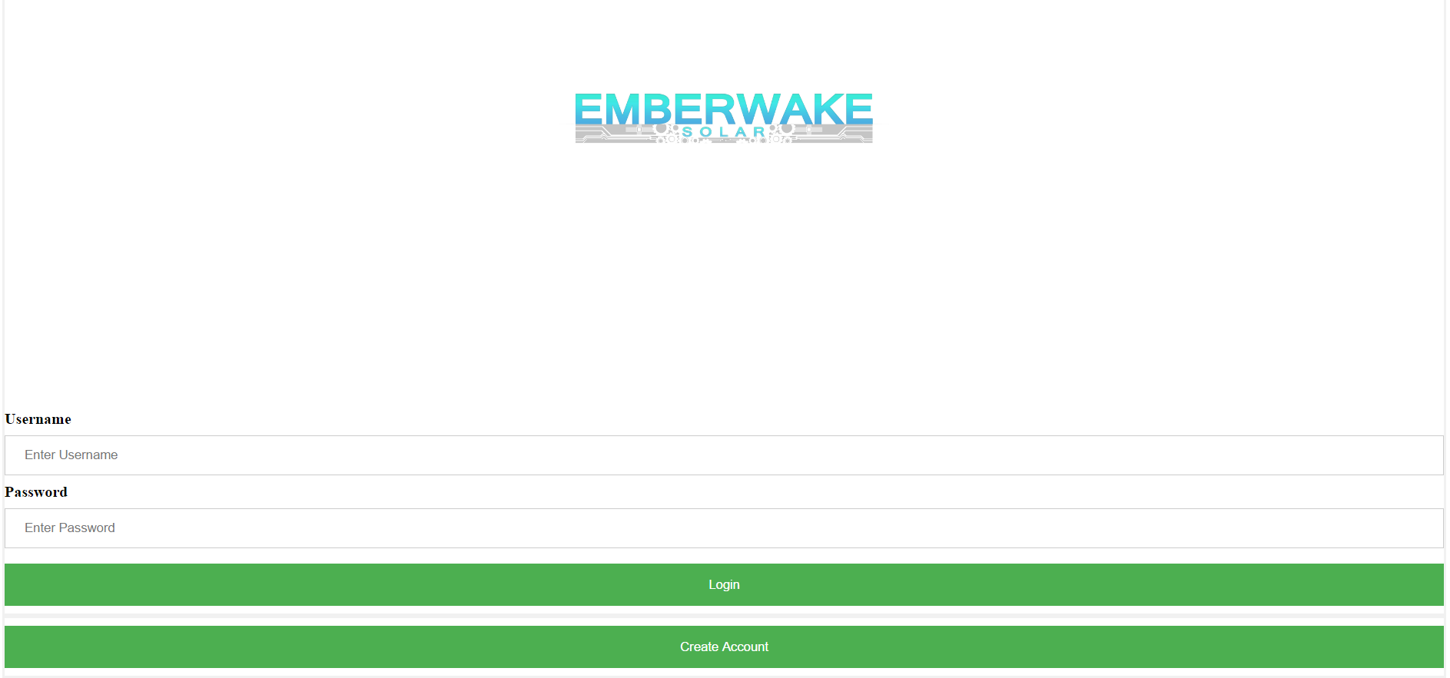
User Interface
Login Page

Slide 36
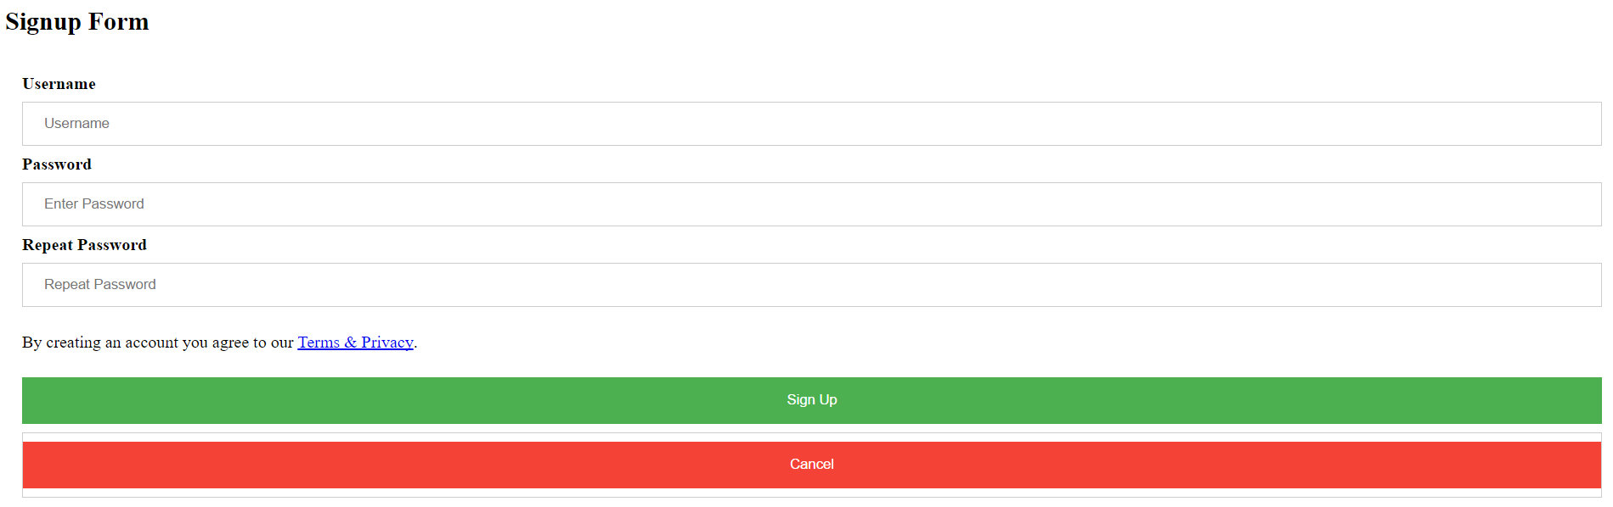
User Interface cont.
Account Page

Slide 37
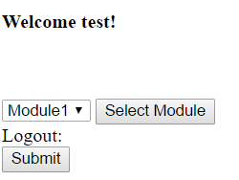
User Interface cont.
Login Page

Slide 38
User Interface
Login or Create an account
Uses hash cryptography to protect password
Login authentication to protect phone from theft
Action Page
Select module and click button to trigger motor.
Controlling Arduino from Raspberry Pi through serial communication
Raspberry Pi sends a byte (ASCII hexadecimal number) which encodes which module was selected. This byte is sent from the PHP code to C code through a pipe, then from the C code to the Arduino though the serial port.

Slide 39
Part 4: Project Evaluation
Goals and Objectives
Critical Specifications
Feasibility

Slide 40
Review of Goals and Objectives
SMART GOAL: Consider power system that can adequately charge all devices in the prototype
Criterion:
Pass Threshold:
Method:
Measured Value:
Result:

Slide 41
Review of Goals and Objectives
SMART GOAL: Successfully create security system to protect prototype.
Criterion: Using sensors and software to create a security system.
Pass Threshold: Security system installed utilizing password encryption and locking mechanism.
Method: Hash encryption for passwords entered into database, and small motor to create a locking mechanism.
Measured Value: N/A
Result: Passed

Slide 42
Review of Goals and Objectives
SMART GOAL: Provide means to improve our customers experience with our prototype
Criterion: Measure the amount of time it takes for a full charge.
Pass Threshold: If it takes less than an hour to fully charge.
Method: N/A
Measured Value: N/A
Result: Failed

Slide 43
Review of Goals and Objectives
SMART GOAL: Making sure the temperature of the battery is within safe area, and the force sensor is sensitive enough
Criterion: Let the battery work for an amount of time and put phone above the force sensor
Pass Threshold: If the fan starts work when the temperature of battery is over 30° and keep it not goes up. If the phone starts to be charged when it is put on the force sensor
Method: N/A
Measured Value: N/A
Result: Temperature-controlled Fan failed. Force sensor success

Slide 44
Review of Prototype Specifications

Slide 45
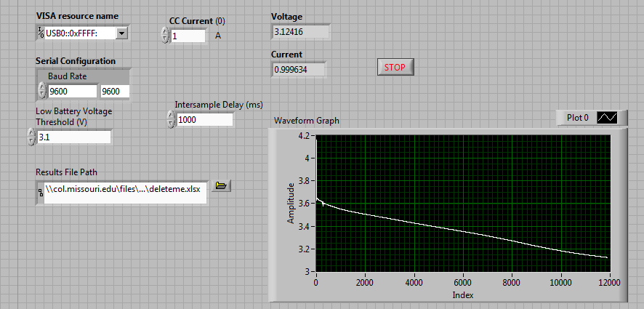
Feasibility of our Prototype
How long do the batteries last?
6600mAh batteries tested at 750mA and 1A draw rate
Using BK Precision 8601 DC Electronic Load
LabVIEW

Slide 46
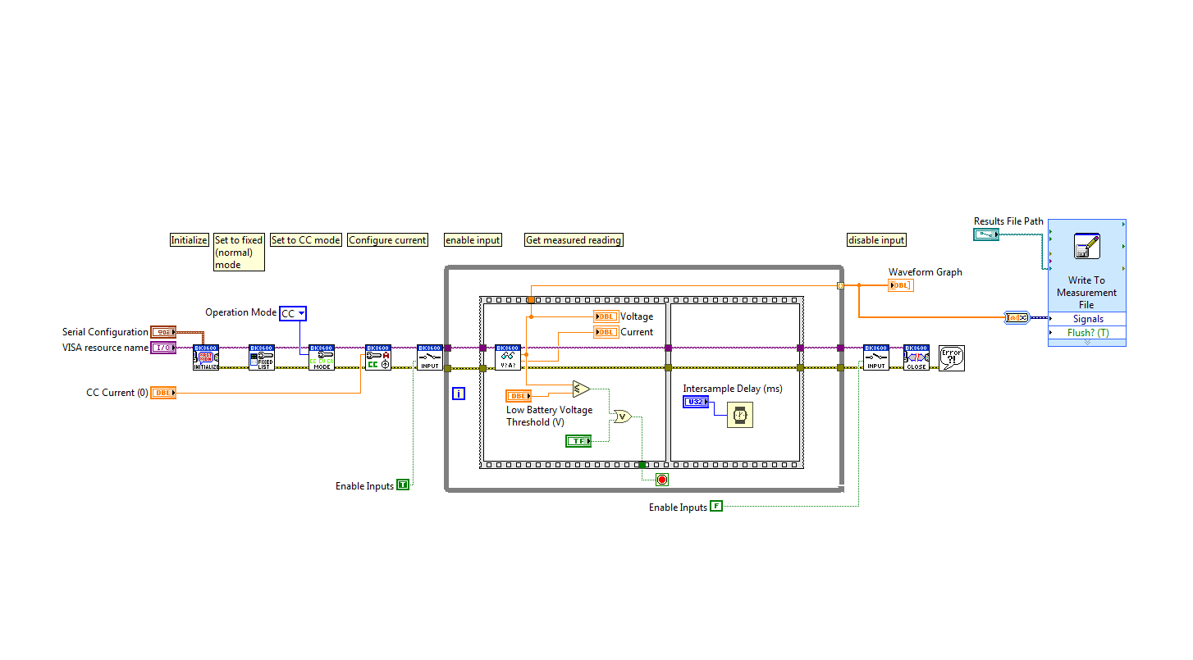

Slide 47
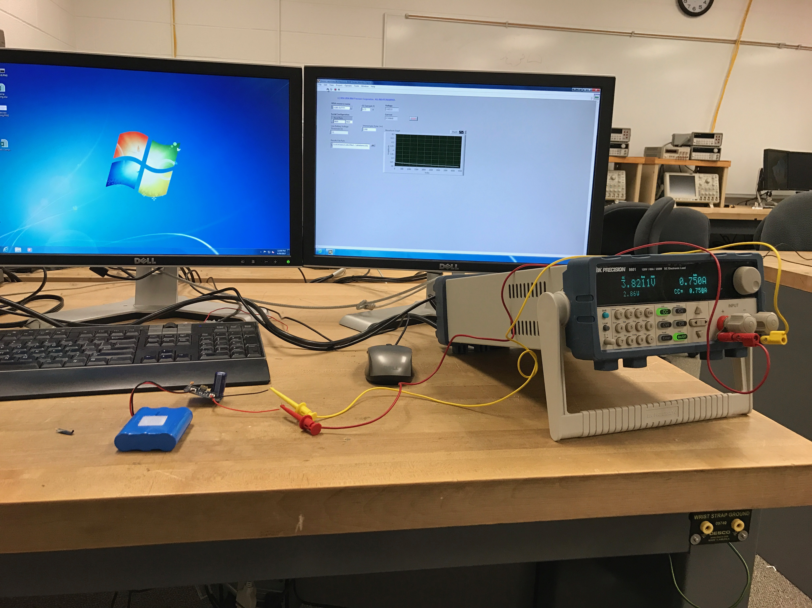

Slide 48
Mostly charged battery at 1000mA, 3.3 hrs starting @ 3.6V

Slide 49
Fully Charged battery at 750mA, 7.7hrs starting @ 3.83 V

Slide 50
Part 5: Financials
Proposed Costs
Actual Costs
Estimated Production Levels
Estimated Production Cost per Unit
Suggested Retail Price

Slide 51
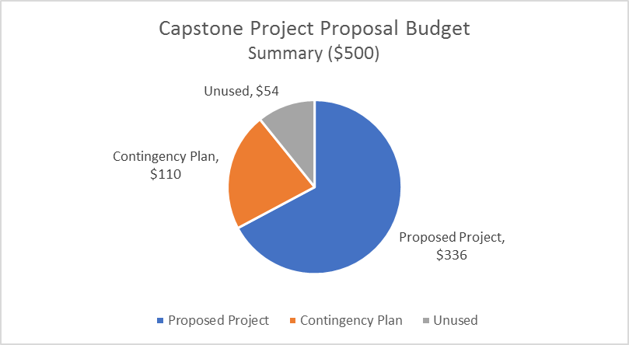
Proposed Costs

Slide 52
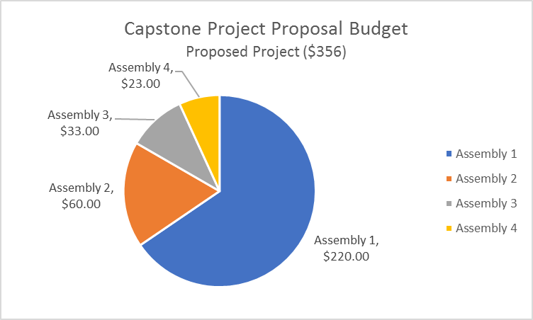
Proposed Assembly Costs

Slide 53
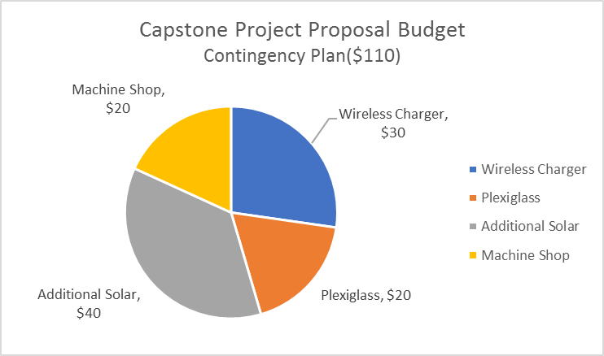
Contingency Plan

Slide 54
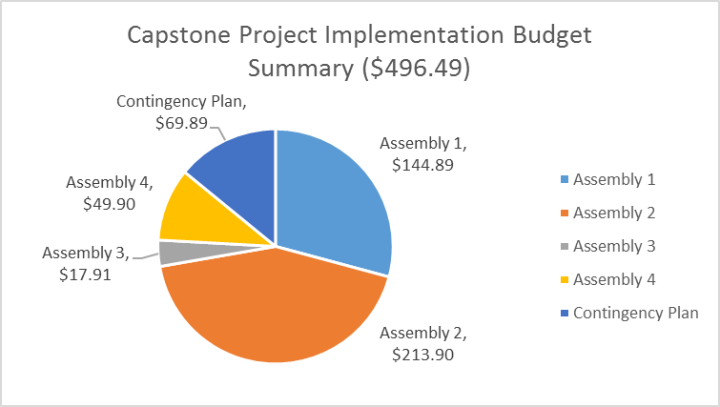
Actual Costs

Slide 55
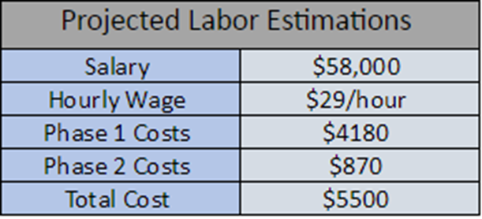
Initial Development Costs

Slide 56
Estimated Production Levels
Number of Workers | 1
Time for Completion | 4 Hours
Worker Wage | $20
Labor Cost | 80$
Average Workday | 8 Hours
Units Per Day | 2 Units

Slide 57
Estimated Production Cost / Unit
Production Cost
Labor | $80
Parts | $670
Total | $750
Notes:
Technician working 5hr at 20$/hr
$50 for real lock and metal
Additional reduced costs when bulk ordering

Slide 58
Suggested Retail Price
Method 1
Location Purchases Device
Free usage
Cost of Production | $750.00
Shipment & Delivery Fee | $24.99
2 Year Warranty (Optional) | $85.99
Total Production Cost | $860.98
Profit Margin | $2139.01
Total Purchase Cost | $2999.99

Slide 59
Suggested Retail Price
Method 2
Device provided free of charge
Hourly rate to charge devices
Cost of Production | $750.00
Shipment & Delivery Fee | $24.99
Total Production Cost | $774.99
Hourly rate | $1.50
Endless Session | $10.00
Estimated Payback Time | 550 Hours

Slide 60
Part 6: Prototype Timeline
Estimated Timeline
Actual Timeline

Slide 61
Timeline - Hunter

Slide 62
Timeline - Trevor

Slide 63
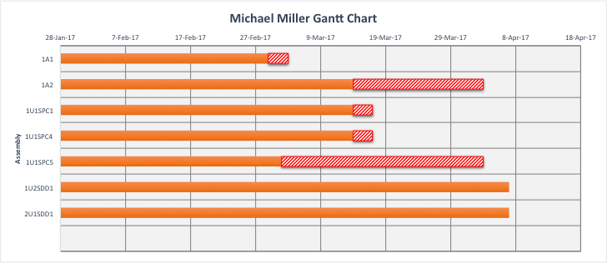
Timeline - Michael

Slide 64
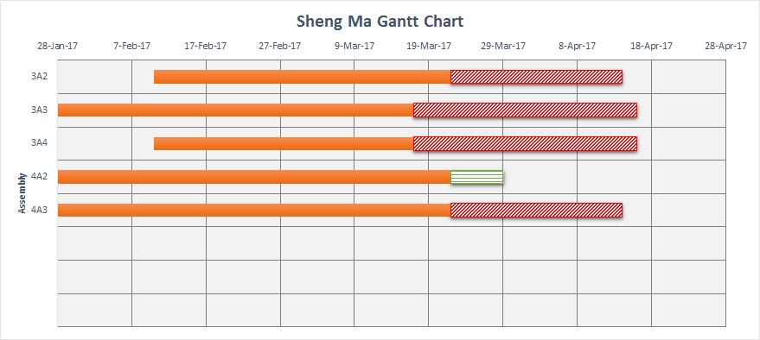
Timeline - Sheng

Slide 65
Part 7: Summary and Conclusions
What did we accomplish?
What did we learned?
How was this beneficial?
Notes:
Sheng

Slide 66
Questions?

